Slide 1
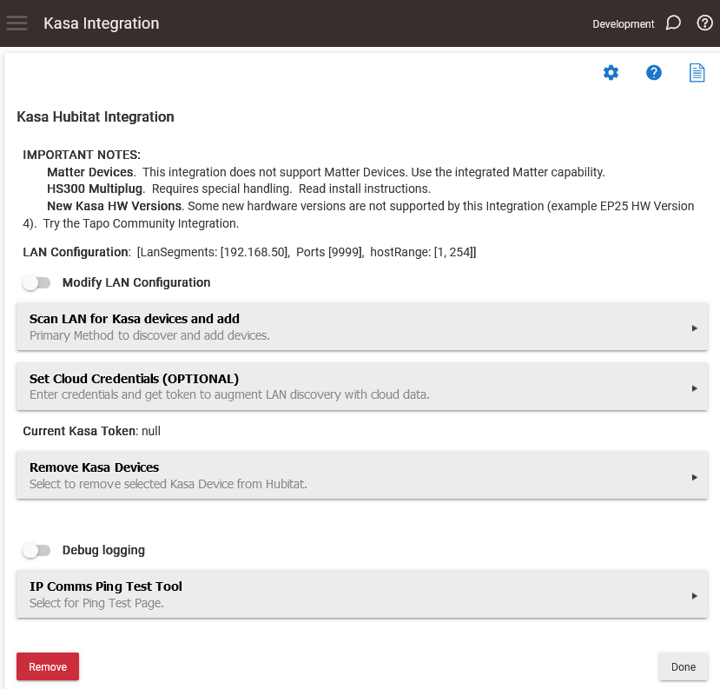

Slide 2
New Start Page Actions
Modify LAN Configuration
used for complex LANs used by very advanced users.
Allows selection of multiple segments and different ports for the discovery.
Scan LAN for Kasa devices and add
SCANS using UDP and (if there is a token will then queries cloud.
Cloud will not modify defices discovered in LAN.
Set Cloud Credentials
Optional. Also enables CLOUD device control (token is required for that control)

Slide 3
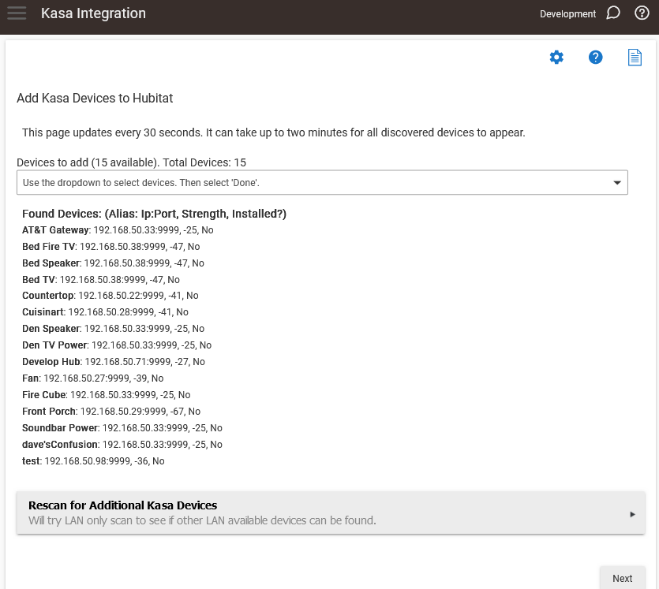

Slide 4
Add devices page
Lists the found devices with IP (or CLOUD), port, and Signal Strength
Sample page was UDP discovery only (no cloud credentials set).
One device was missing, so I immediately selected Rescan for Additional Kasa Devices
See next page. The missing device was found (Bed Fan)

Slide 5
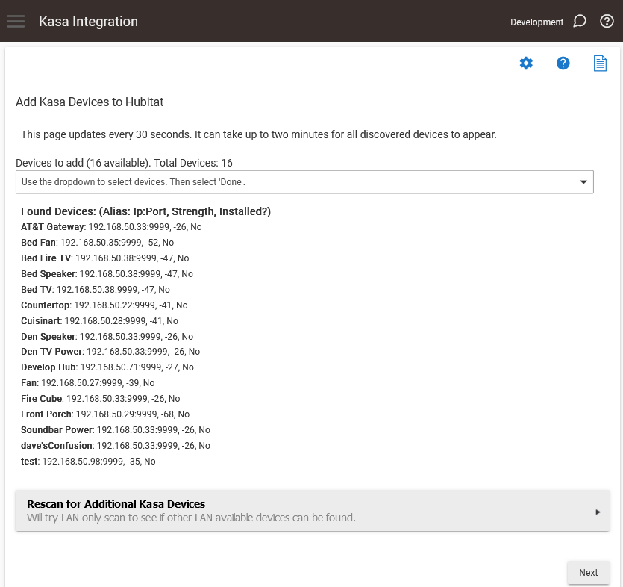

Slide 6
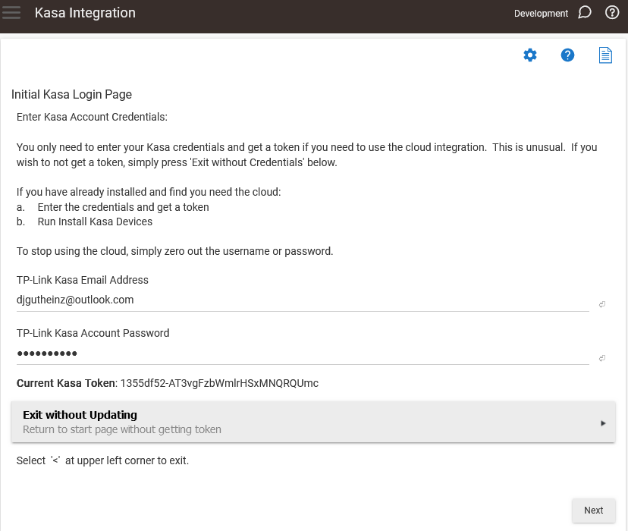

Slide 7
Add Credentials Page
When valid credentials are entered will create a valid Kasa token
Automatically updates when the Email and/or Password are changed.
Enables cloud interface in APP (discovery) as well as devices
To disable cloud, simply change E-Mail address to an invalid value.

